Slide 1
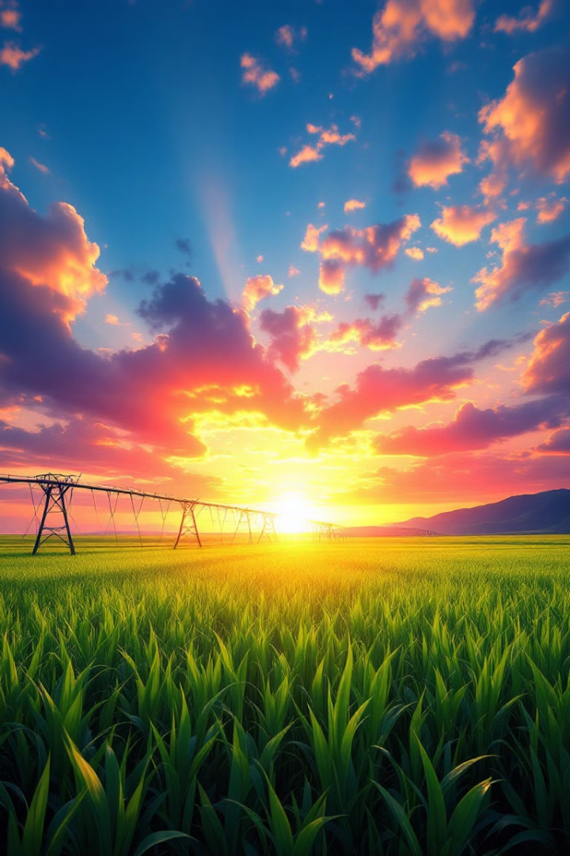

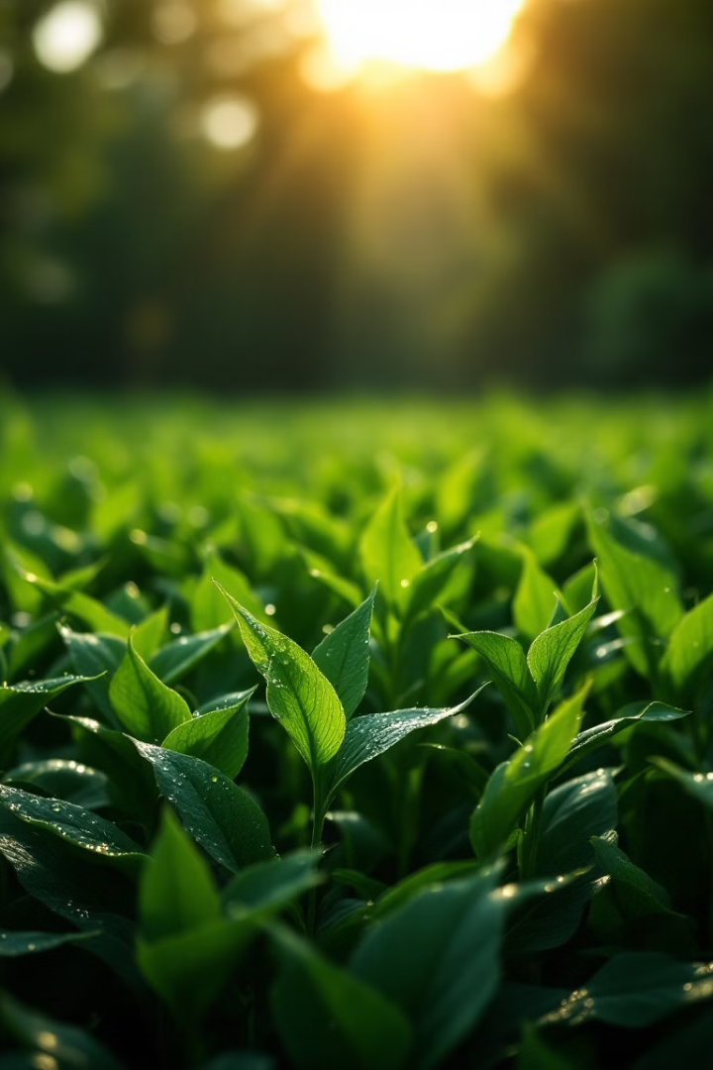
CSE-3118 Microprocessors and Microcontroller Lab
-A Smart Irrigation and Monitoring System

Slide 2
CSE-3118 Microprocessors and Microcontroller Lab
-A Smart Irrigation and Monitoring System

Slide 3

Team Members
MD. Fazlay Rabbi ID: 20220104138
Rezwan Ahmed ID: 20220104129
Redwan Hossen ID: 20220104147
Jakaria Mahmud ID: 20220104141

Slide 4
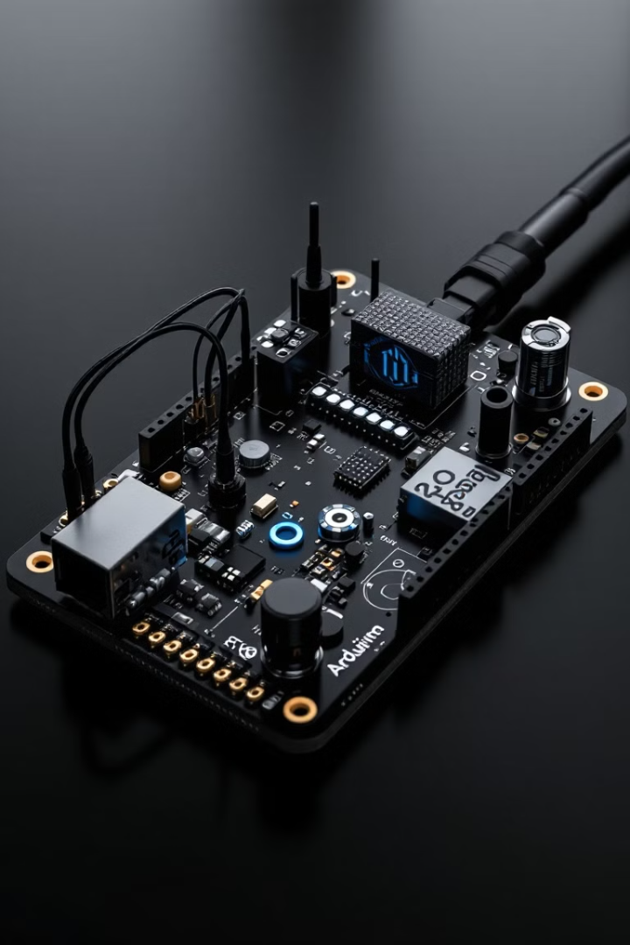
Smart Irrigation and Monitoring System
Often, we forget to water our precious plants, yet they are a valuable treasure that adds beauty to our surroundings and supports life.However, due to busy schedules or lack of awareness, plants often suffer from neglect.
To address this, we propose a Smart Irrigation System using Arduino

Slide 5
Objectives
Automatic Irrigation
Plant Health Monitor
Cost-Effectiveness
Automates water delivery based on
real-time soil moisture data
Able to see real time soil moisture and temperature around environment
An affordable and scalable system for farmers and gardeners .

Slide 6

Motivation
Plant Enthusiasts
To Fight Drought
Struggle to maintain proper watering schedules due to busy lifestyles or travel.
Enable efficient and environmentally responsible agricultural practices.

Slide 7
Required Components
Arduino
Soil Moisture
Sensor
ESP-8266
Water Motor
PowerSupply
The brain of the system, processing sensor data and controlling
For IoT integration and wifi compatibilities
Relases the Water to the garden
Suplies power to the microcontroller and water motor
Determines soil moisture
Relay Module
Dht 11
Buzzer
Breadboard
Measures Humidity and environment temperature
For sound
For connection purposes
Works as a switch

Slide 8
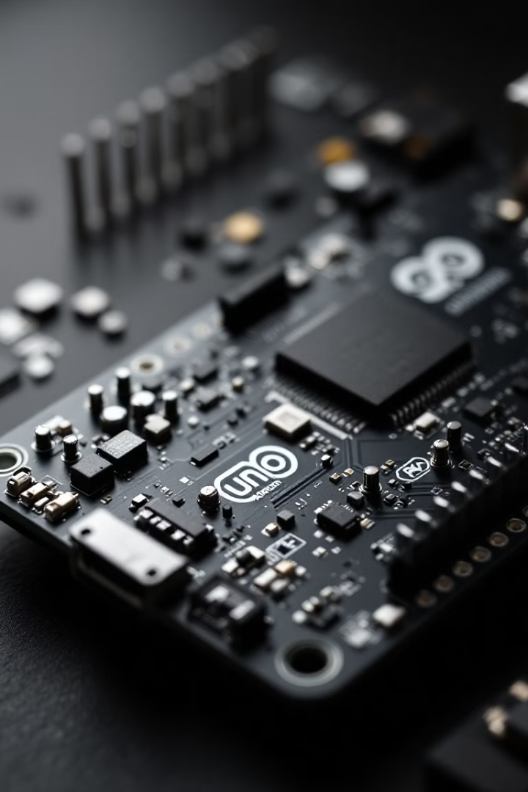
Arduino Microcontroller
The brain of the system.
Processes data from sensors and controls actuators
A low-cost, programmable platform for automation.

Slide 9
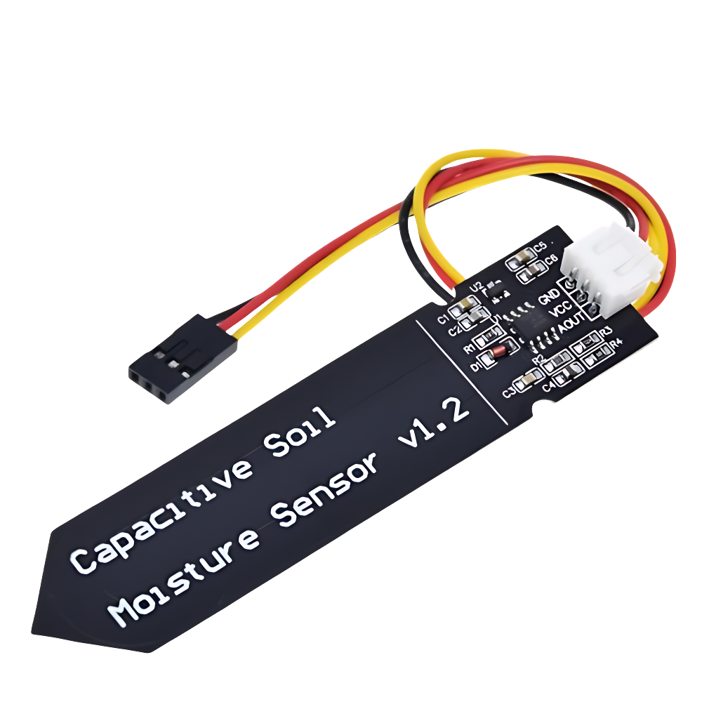
Soil Moisture Sensor
Checks the moisture
Sends data to the microcontroller
Crutual component
Ensures whenever the soil is dry water supply is on

Slide 10
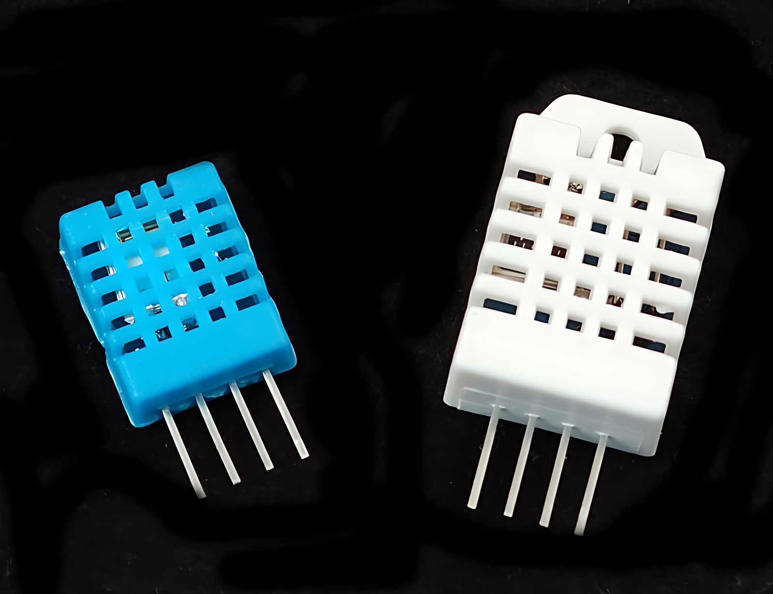
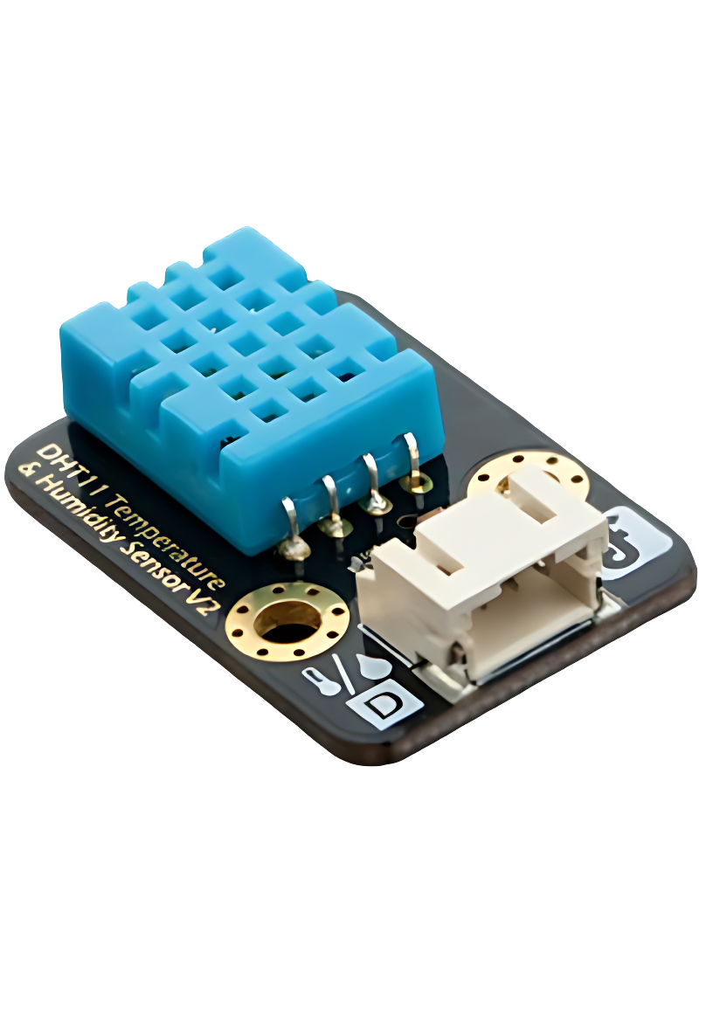
DHT-11/12
Monitors environmental conditions.
Measures temperature and humidity to provide additional data for irrigation decisions.
Helps optimize irrigation based on weather conditions

Slide 11
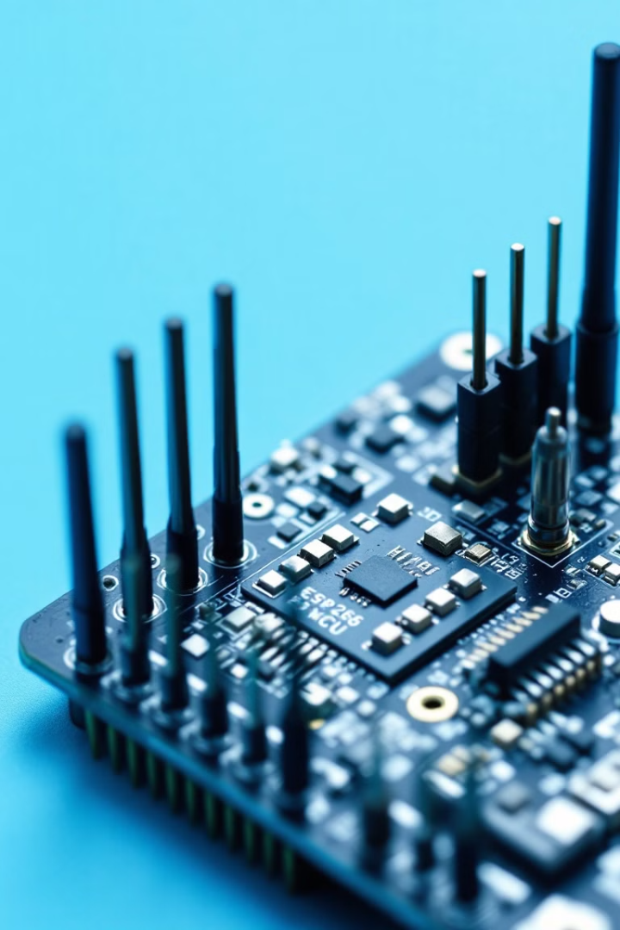
ESP 8266 – Node MCU
Enables remote monitoring and control.
Sends sensor data to a mobile app or web interface and allows remote control of the system.
Provides real-time updates and control, making the system user-friendly and accessible.
WiFi integration

Slide 12
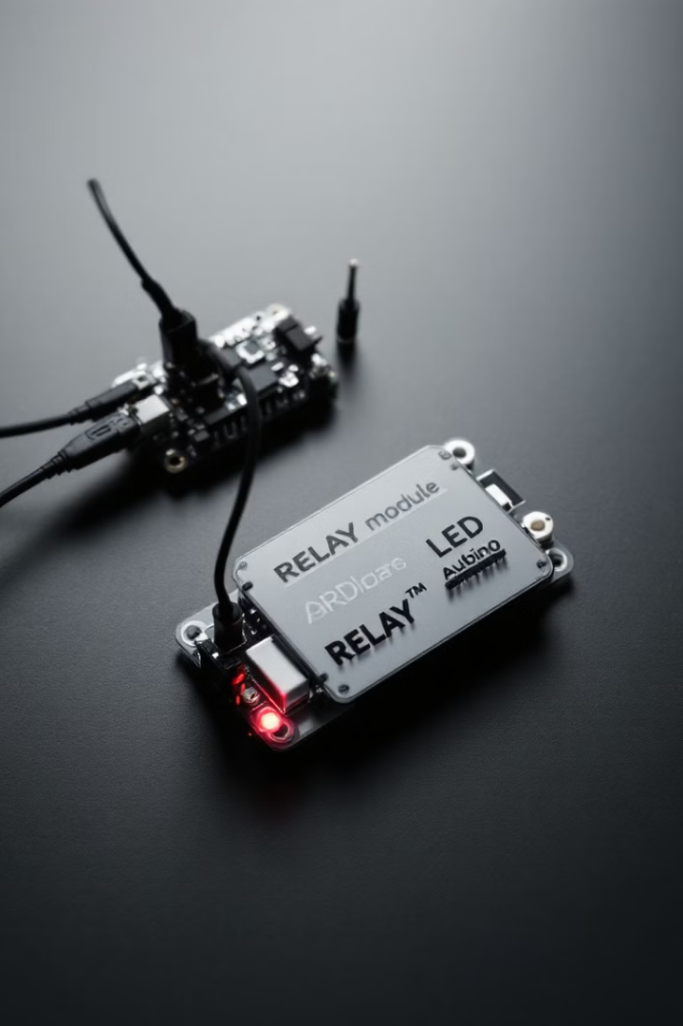
Relay Module
Acts as a switch for high-power devices.
Controls the water pump based on signals from the Arduino.
Safely connects low-power Arduino to high-power devices like the water pump.

Slide 13
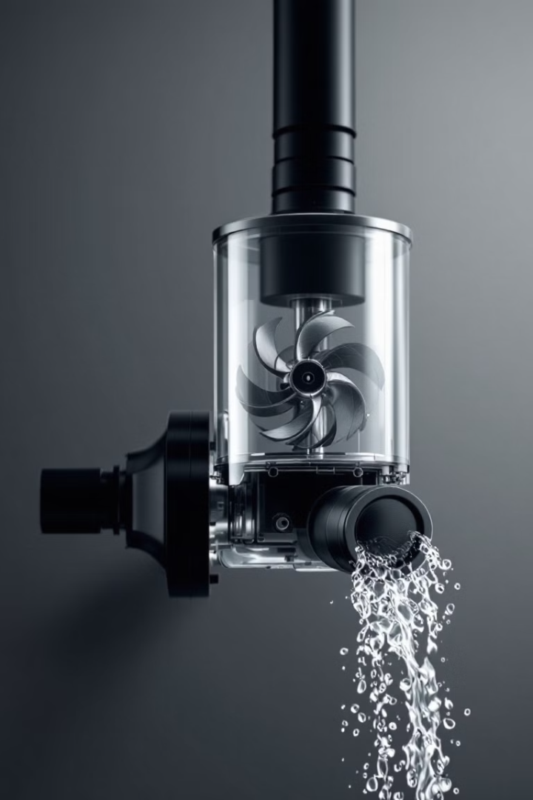
Water Pump
Supplies water to the plants
Activated by the relay module when the soil moisture level is low.
Automates the watering process, eliminating manual effort.

Slide 14
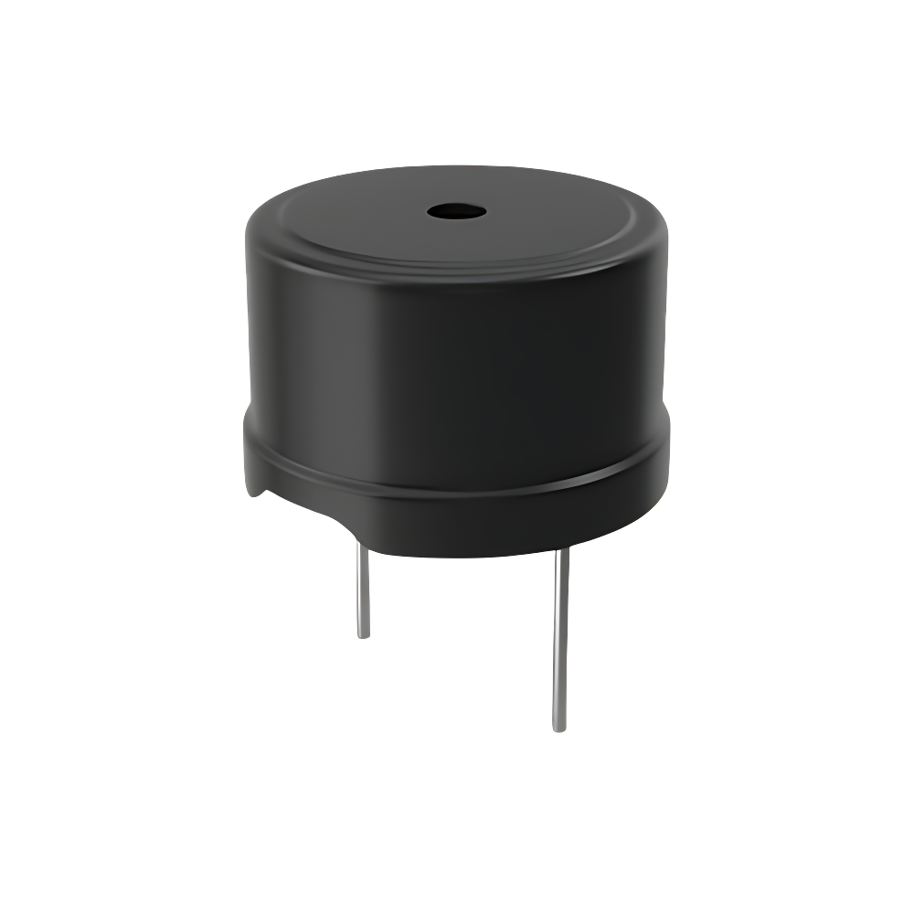
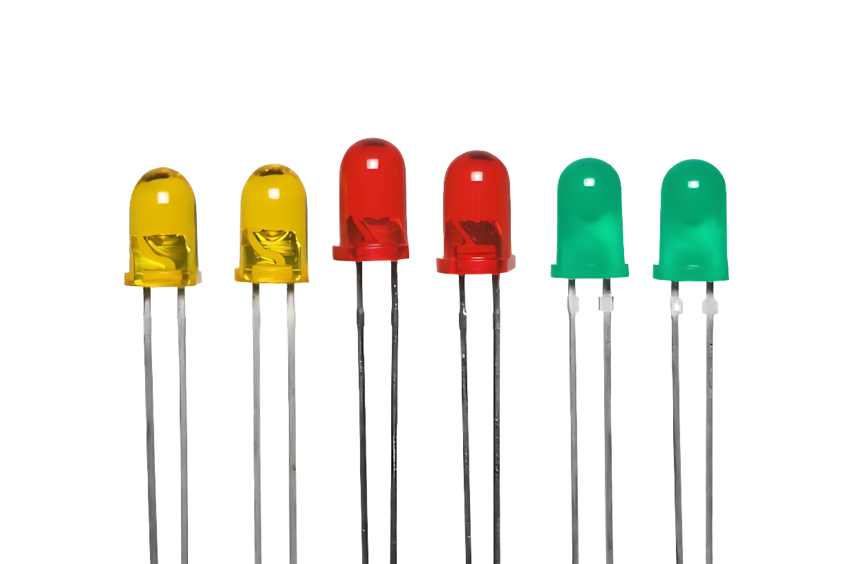
Buzzer & LEDS
Audible alert system & Visual indicators.
Alerts the user in case of critical conditions (e.g., pump failure, extremely dry soil).
Ensures the user is notified of any issues that require attention.
Show system status
Provides quick, easy-to-understand feedback about the system’s operation.

Slide 15
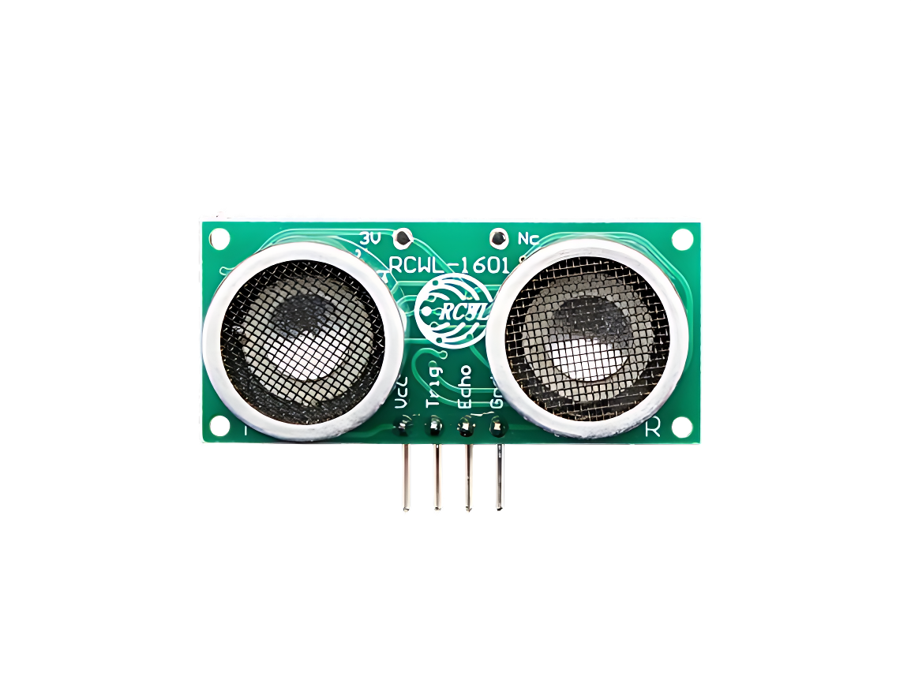
Ultrasonic Sensor
Measures distance or water level in a tank.
Ensures the system knows when the water tank is empty or full
It measures the distance to the water surface and calculates the water level.
The ultrasonic sensor is placed above the water tank.

Slide 16
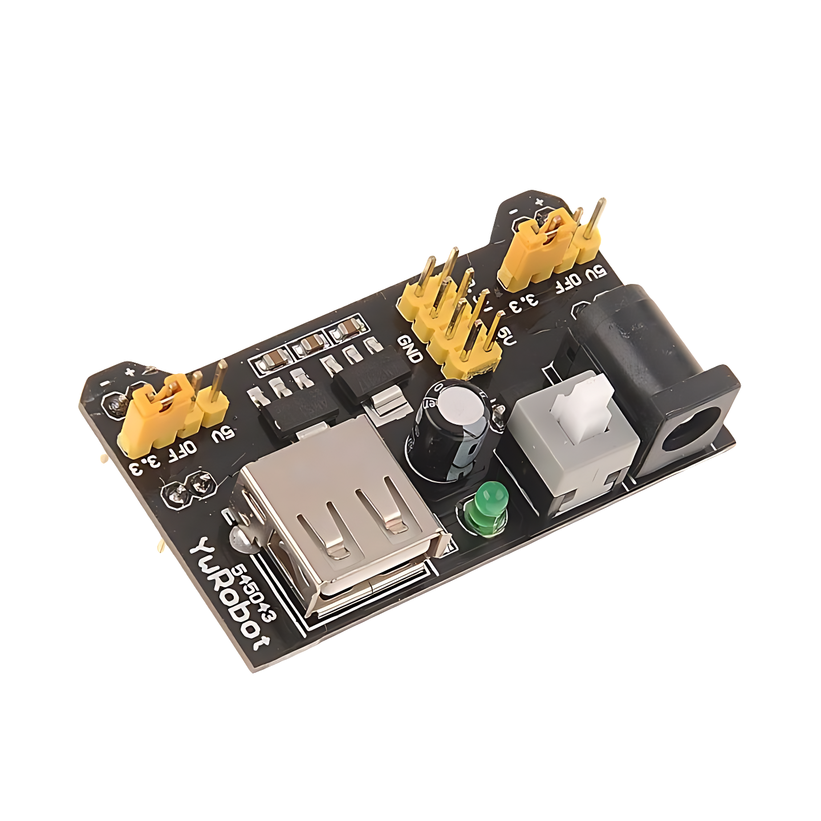
Power Supply
The power source that runs the system.
Provides power to Arduino, sensors, and the pump.
Can be a battery or direct AC supply.

Slide 17
System Design/Diagram
Wi-Fi Module
Buzzer, LED
Arduino
Soil Moisture Sensor
Relay Module
Water Pump

Slide 18
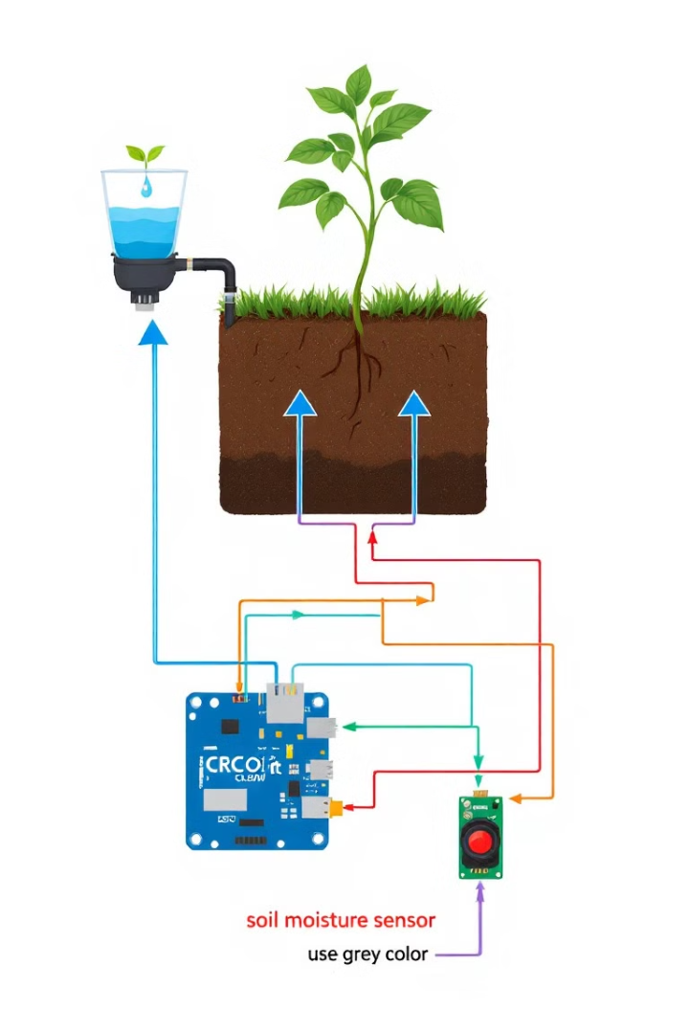
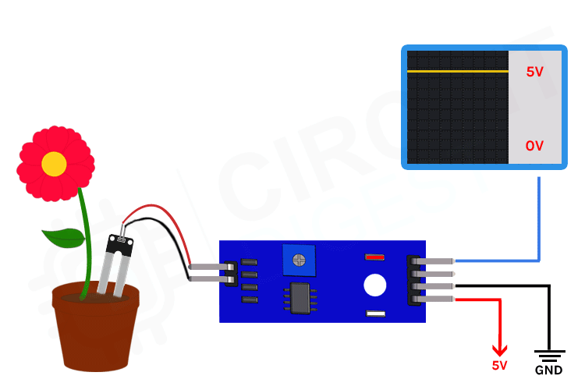
Working Procedure

Slide 19
Environmental Benefits
Saves water through precise irrigation
Reduces runoff and chemical pollution
Optimizes energy and resource use
Supports drought-prone areas
Encourages greener spaces and sustainability

Slide 20

Budget List
Components | Quantity | Price(approximate)
Arduino | 1 Piece | 700
ESP-8266 | 1 Piece | 500
Soil Moisture sensor | As Required | 600
Relay Module | 1 Piece | 150
Water Motor | 1 Piece | 300
Power Supply | 1 Piece | 500
Dht-11 | As required | 300
LEDs | As required | 100
Resistors | As required | 50
Jumper Wires | As required | 150
Water tubes | As required | 100
Breadboard | 1 Piece | 150
Buzzer | 2 Pieces | 50
Other purposes | As required | 400
Total |  | 4050/=
*Prices may vary at availability and taken from store.roboticsbd.com

Slide 21

Target Audience
Gardeners
Plant Enthusiasts
Maximize crop yields and reduce water consumption.
Leave for a certain time and

Slide 22
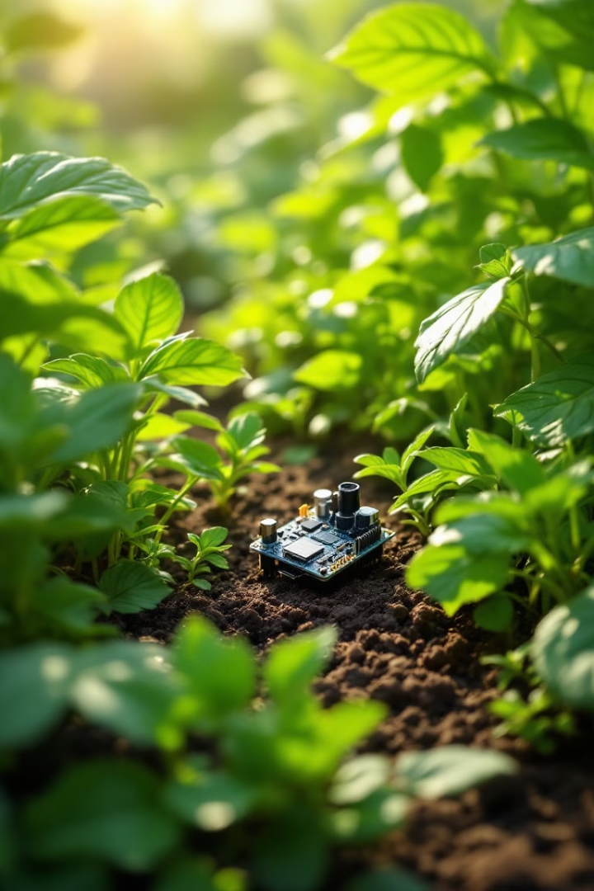
Future Improvements
Mobile App Integration – Develop an app to remotely monitor and control irrigation via ESP8266.
Solar-Powered System – Use solar panels to make the irrigation system more energy-efficient and eco-friendly.
Multiple Zone Irrigation – Modify the system to water different plants/zones independently, optimizing water usage.
Water Level Monitoring – Add a water level sensor in the reservoir to prevent pump damage due to dry running.

Slide 23
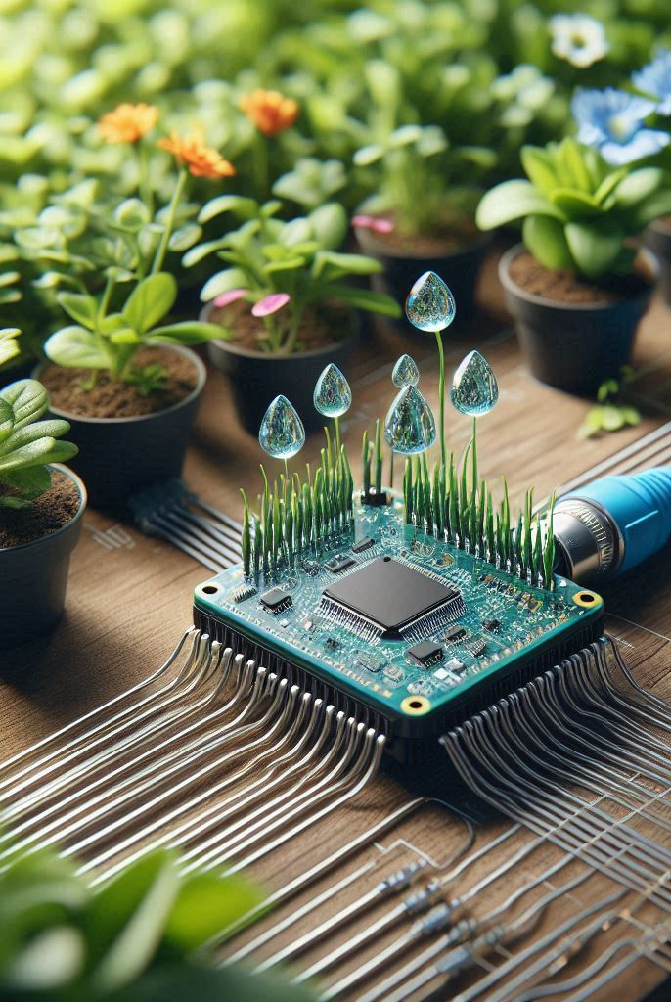
Challenges and Problems
Sensor Accuracy & Calibration
Internet Connectivity (ESP8266)
Cost Considerations
Overwatering or Underwatering
Rectangular area covereage

Slide 24
Prototype

Slide 25
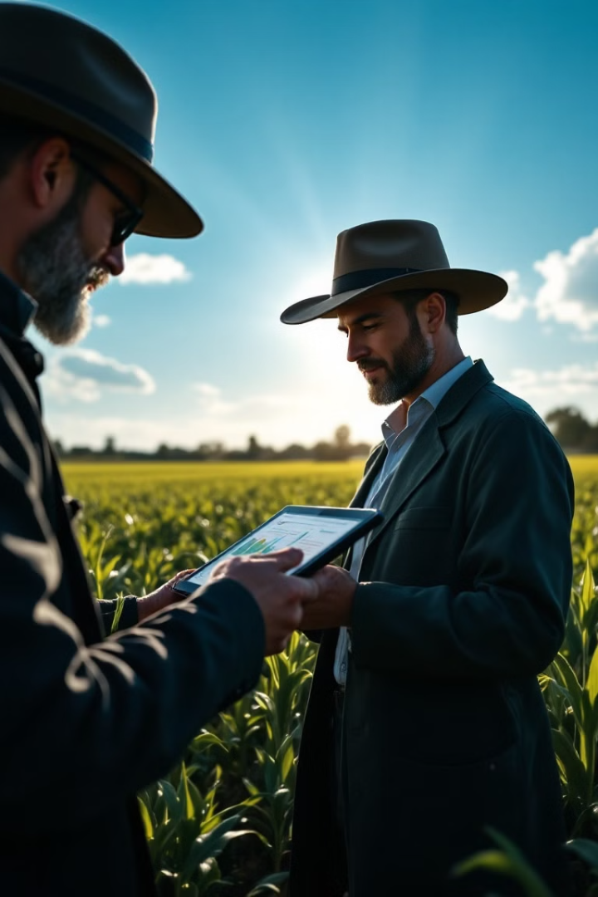


Tools and Softwares
For Development
For Circuit Design

Slide 26
References
www.lexica.art
www.robotonbd.com
www.arduino.cc
www.tutorialspoint.com
www.shutterstock.com

Slide 27
Thank You

